Slide 1
Food Order & Delivery System Design

Slide 2
Agenda
Business Model Overview
Domain Identification & Prioritization
Bounded Contexts & Context Map
System Architecture (C4 Model)

Slide 3
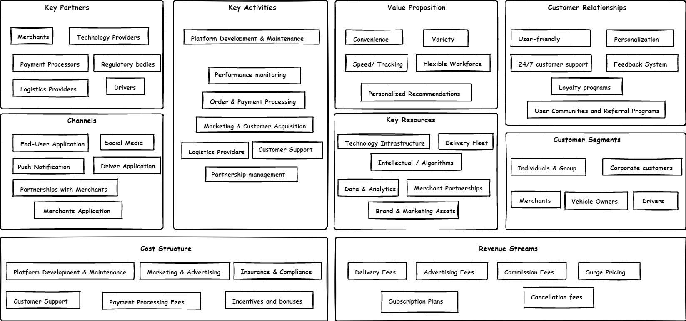
Business Model Canvas Overview

Slide 4
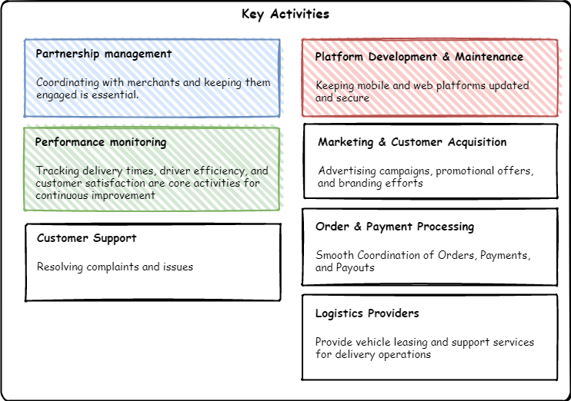
Business Model Canvas

Slide 5
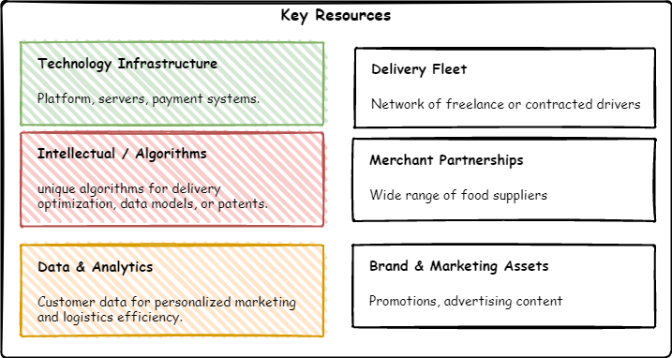
Business Model Canvas

Slide 6
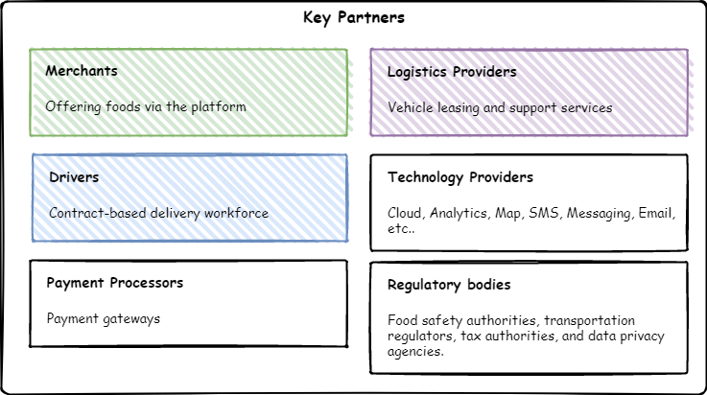
Business Model Canvas

Slide 7
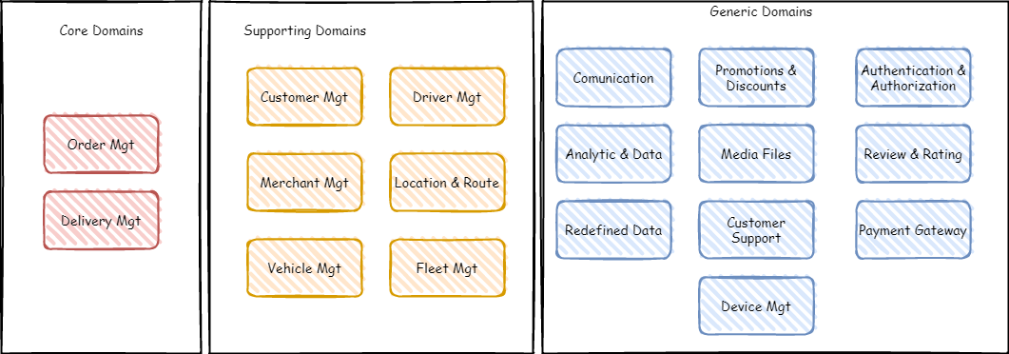
Domain Identification

Slide 8
Domain Prioritization
Priority | Domain | Description
1 | Order Management | Highest business value due to its direct impact on customer satisfaction and revenue generation.
2 | Delivery Management | Critical for ensuring timely and efficient deliveries, directly affecting customer experience.
3 | Authentication & Authorization | Essential for securing the platform, managing user access, and ensuring compliance with security protocols.
4 | Location & Route Management | Important for cost optimization, Unique algorithms for effectively delivery

Slide 9
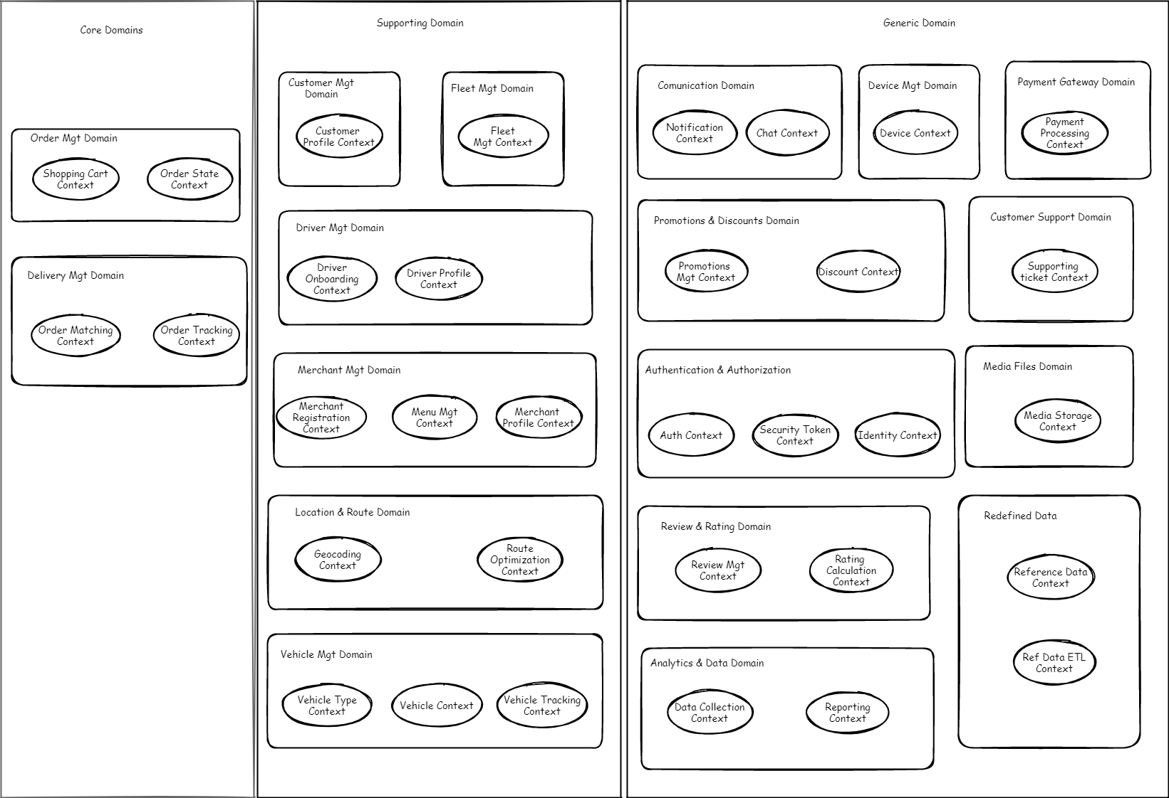
Bounded Contexts

Slide 10
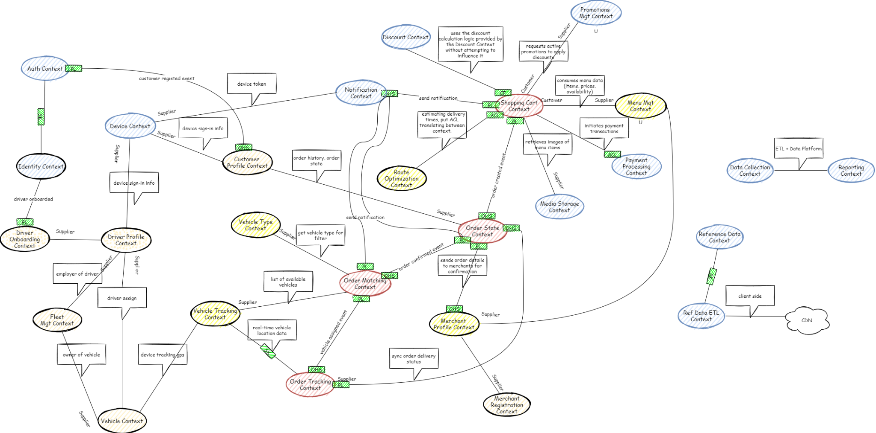
CONTEXTS MAPS

Slide 11
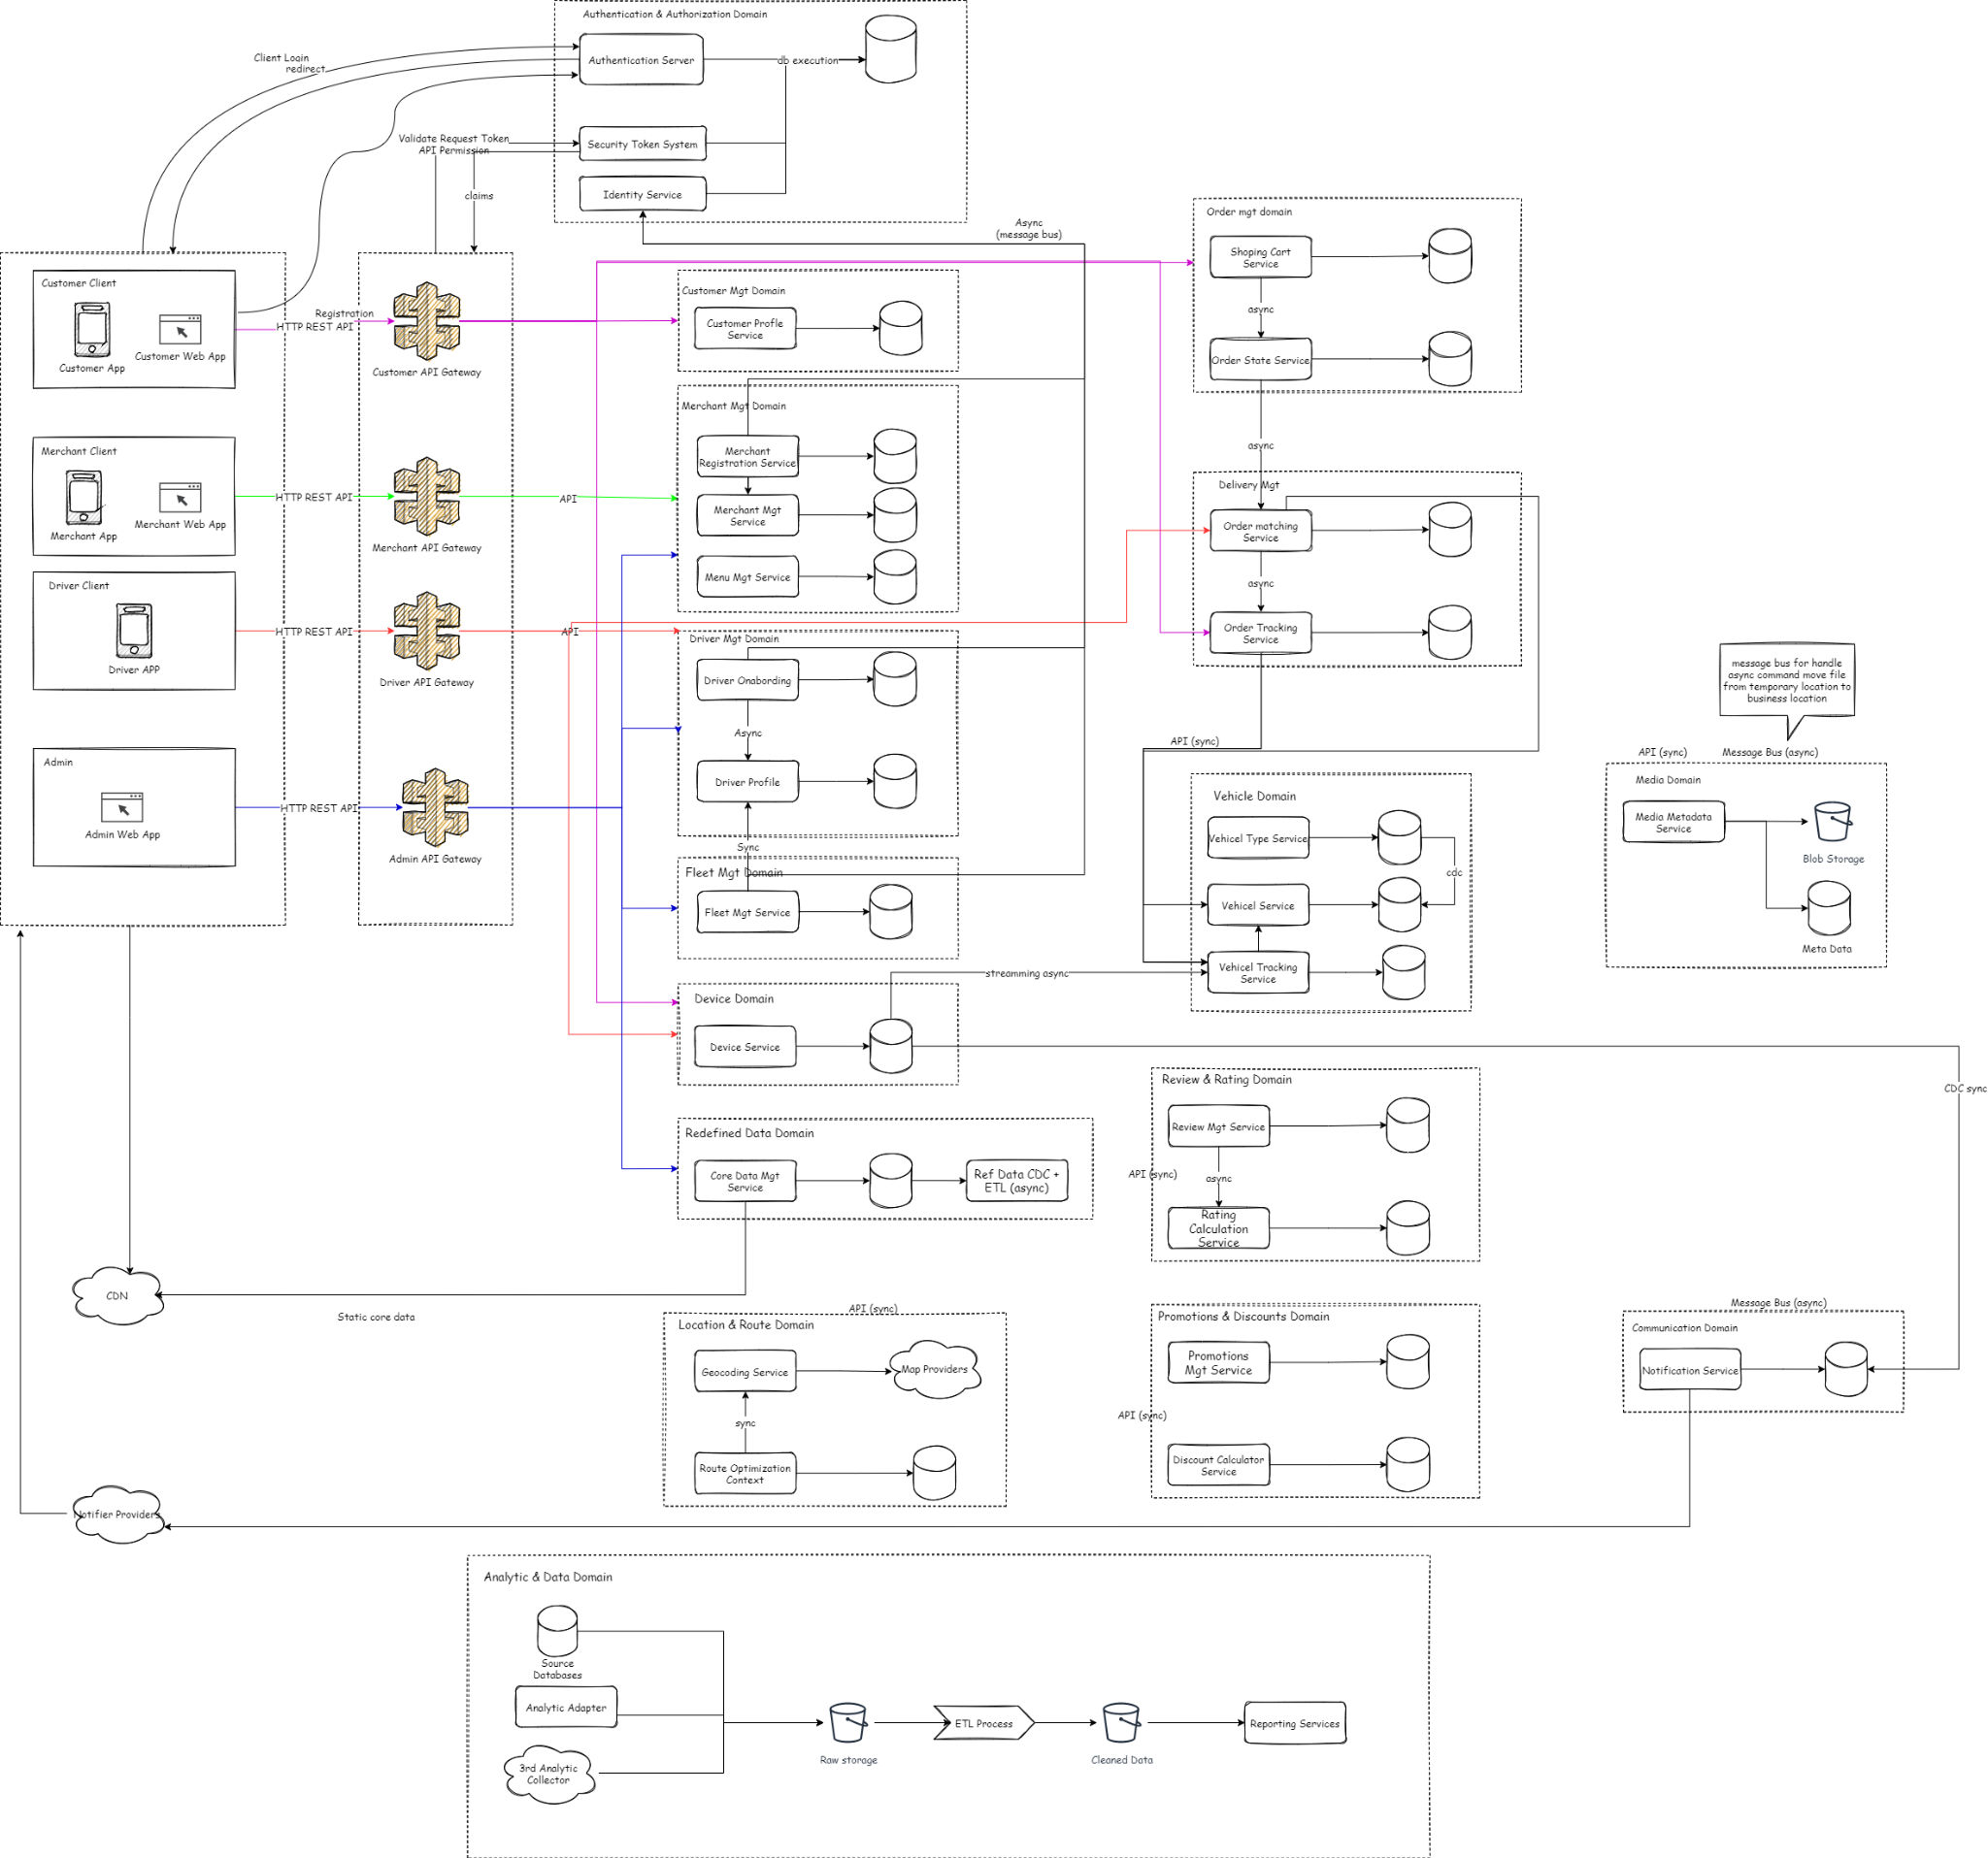
System Architecture
Architect

Slide 12
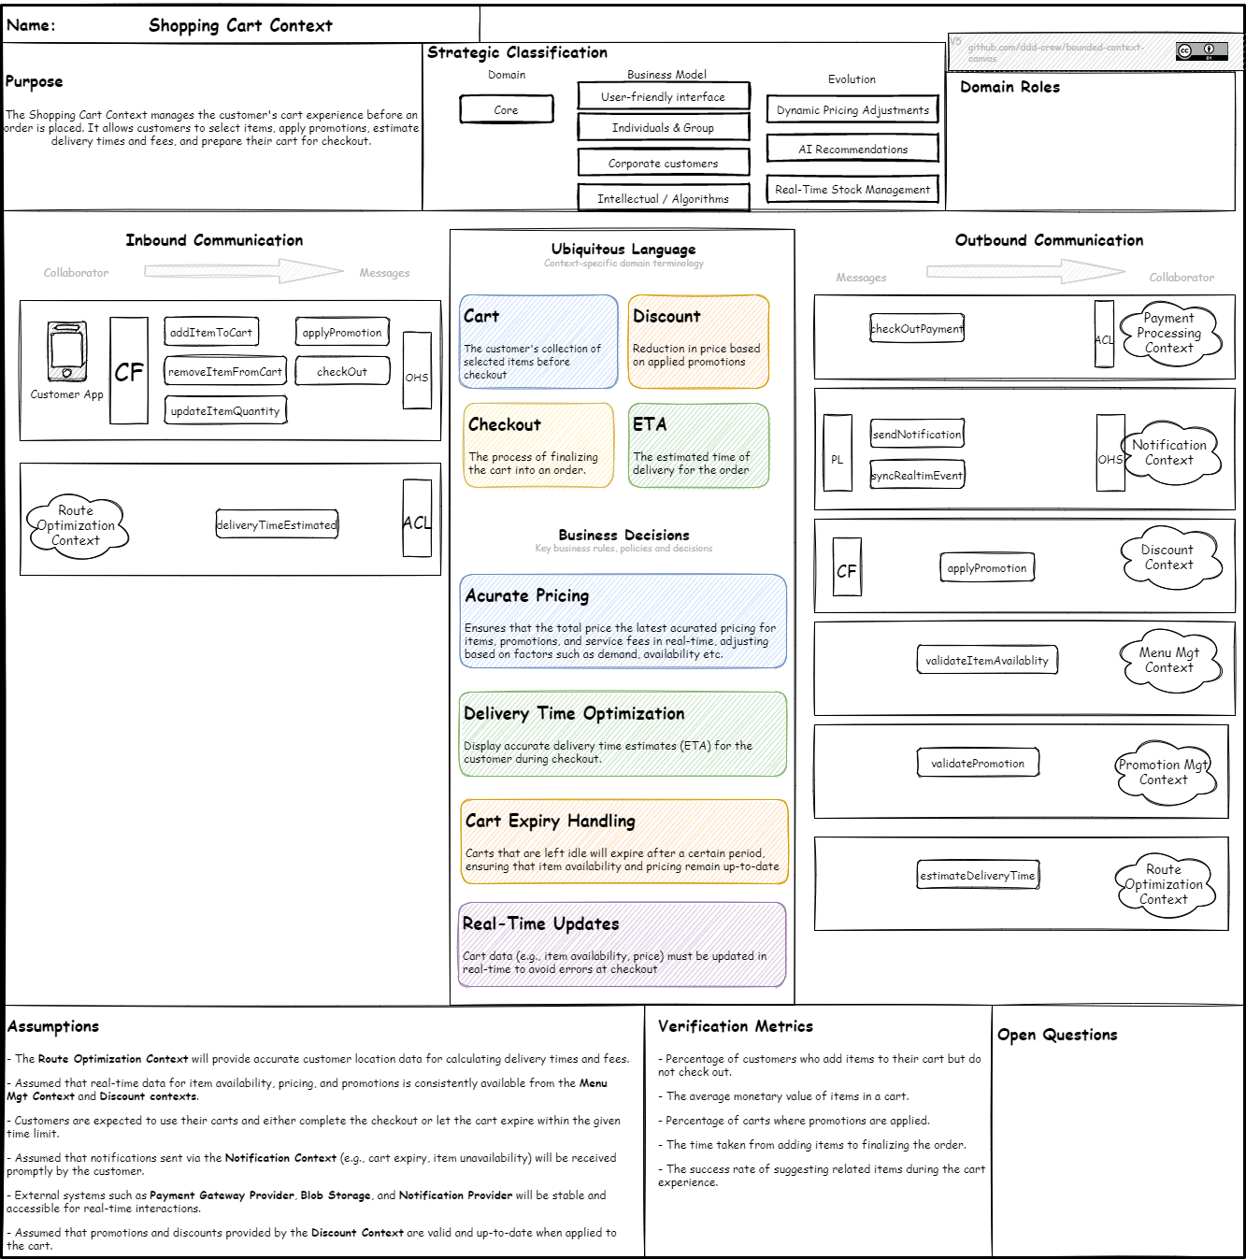
SHOPPING CART BOUNDED CONTEXT

Slide 13
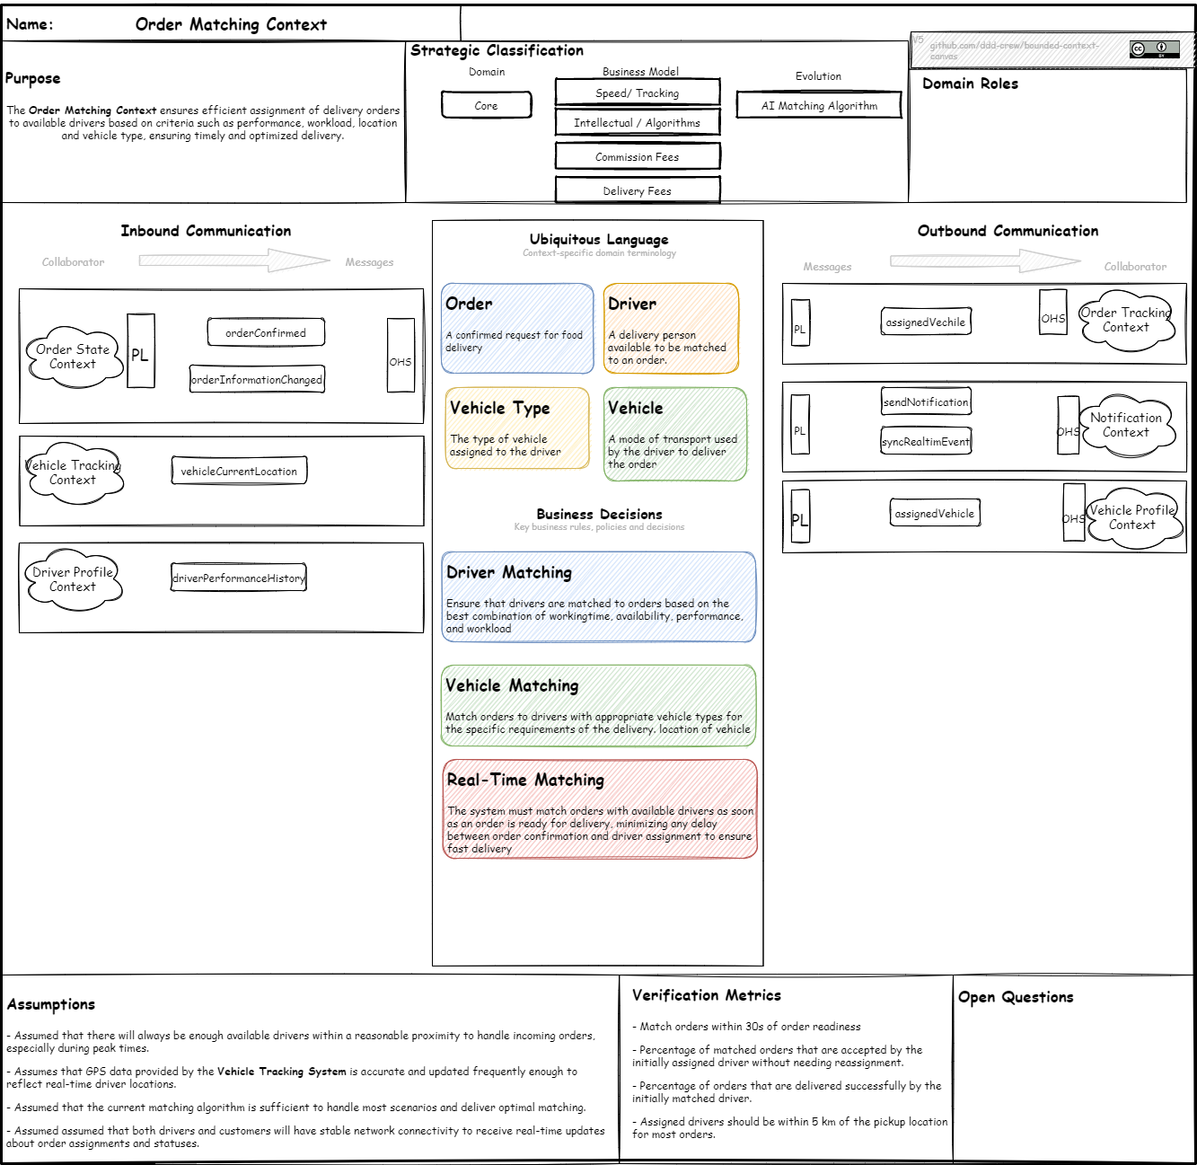
ORDER TRACKING BOUNDED CONTEXT

